Slide 1
OAI-33 Complex Gate - Domino
Group Number: 7
Group Members :
Saksham Gupta – 2019199
Samaksh Gupta – 2019200
Shragvi Sidharth Jha – 2019207
Mihir Chaturvedi– 2019175

Slide 2
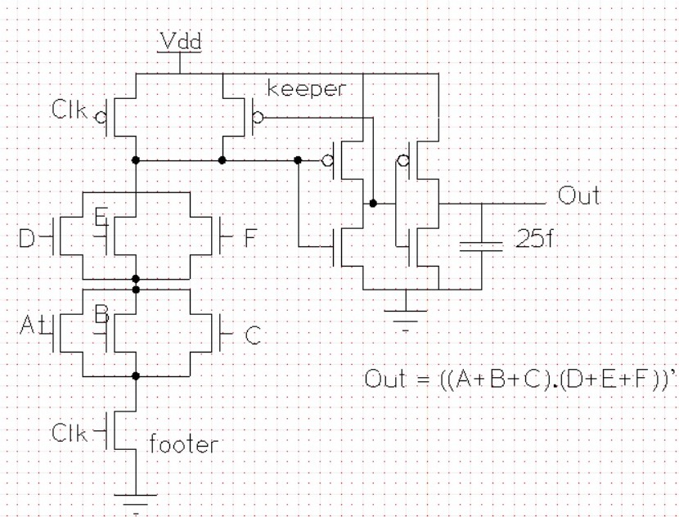
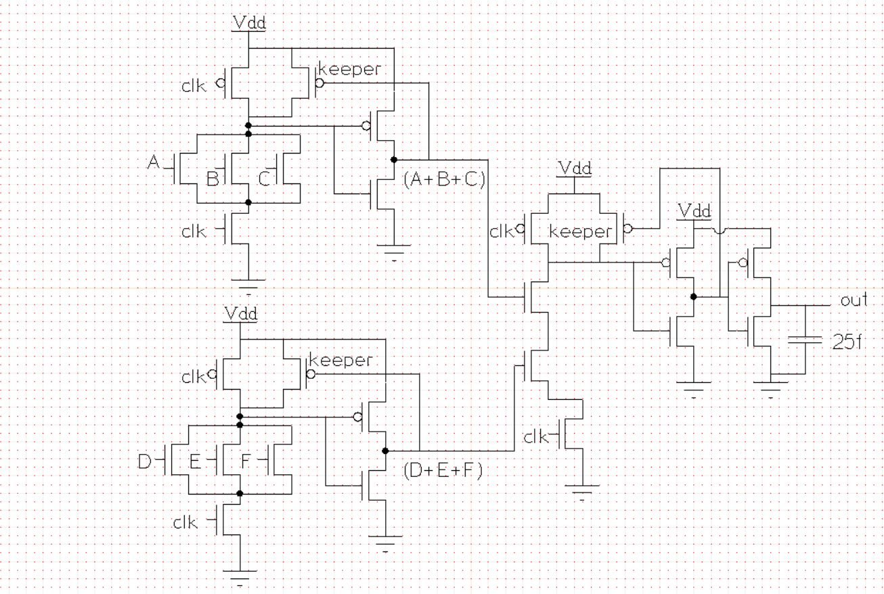
Schematic using XCircuit
COMPLEX
Sizing- A, B, C, D, E, F ,clk (footer): 0.405u
clk(precharge): 0.27u, keeper: 0.135u
Inverters- nmos: 0.34u, pmos: 0.68u
NON COMPLEX
Sizing- keeper: 0.135u
A, B, C, D, E, F ,clk (footer), clk(precharge), A+B+C(nmos), D+E+C(nmos) : 0.405u
Inverters- nmos: 0.34u, pmos: 0.68u

Slide 3
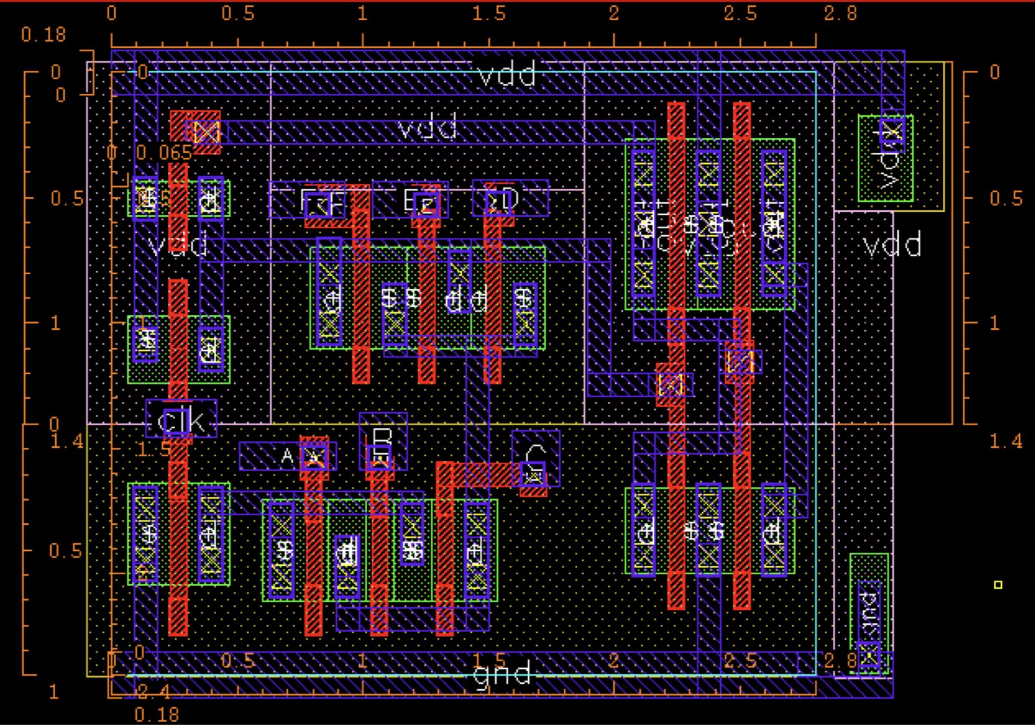
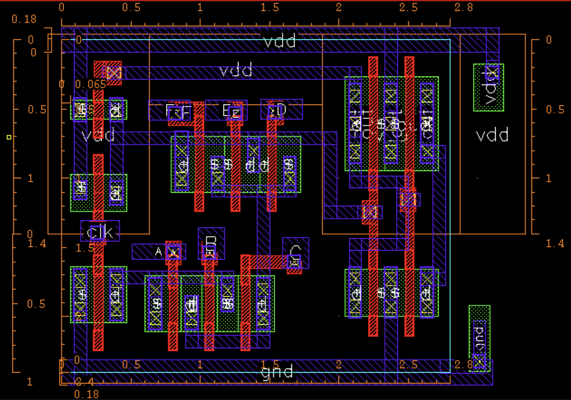
Layout Screenshots (Complex)
Area = 2.4*2.8 = 6.72 um²

Slide 4
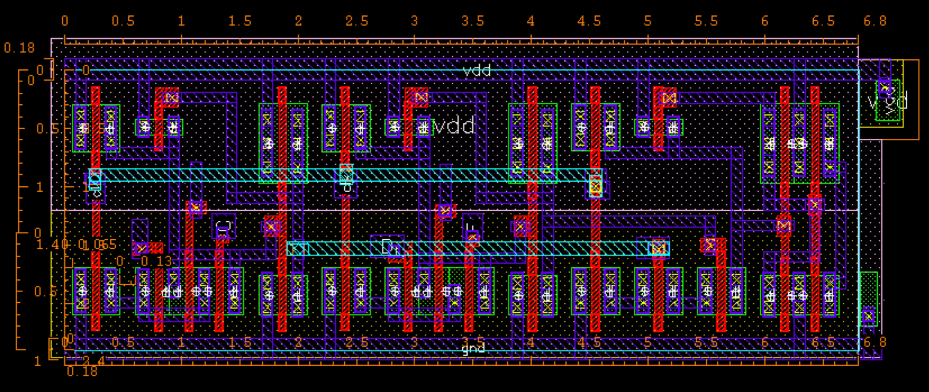
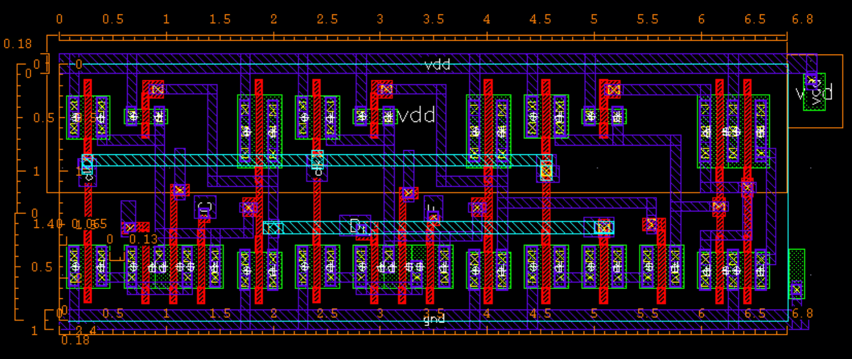
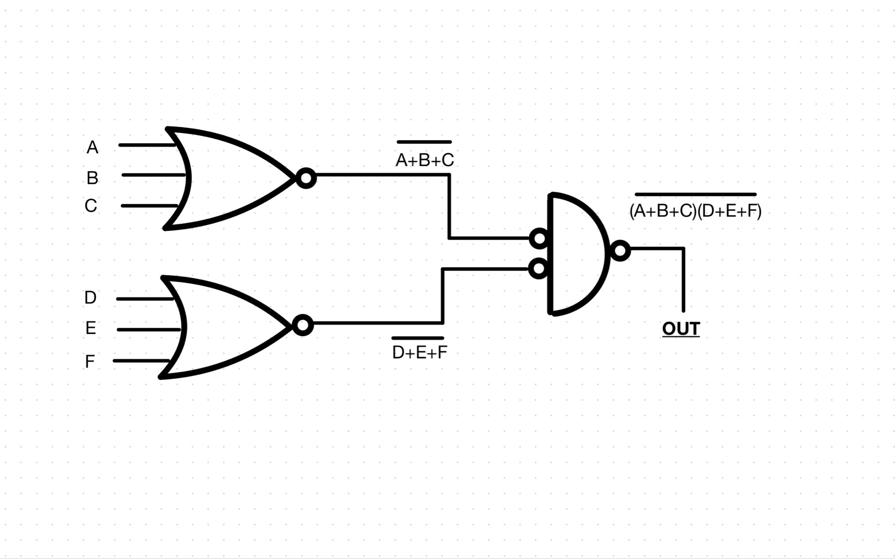
Layout Screenshots (Non-Complex)
Area = 2.4*6.8 = 16.32 um²

Slide 5
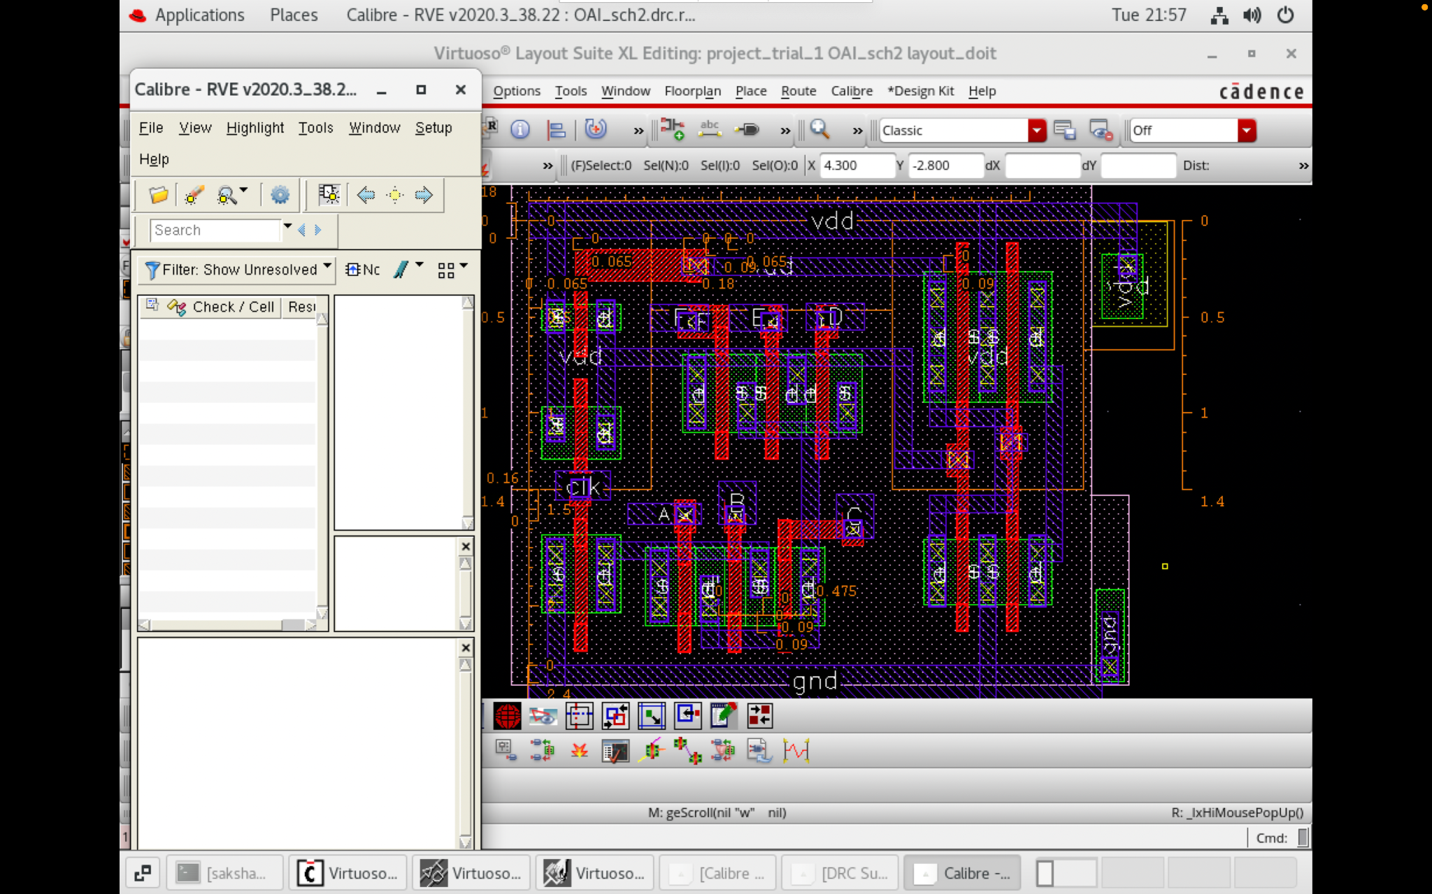
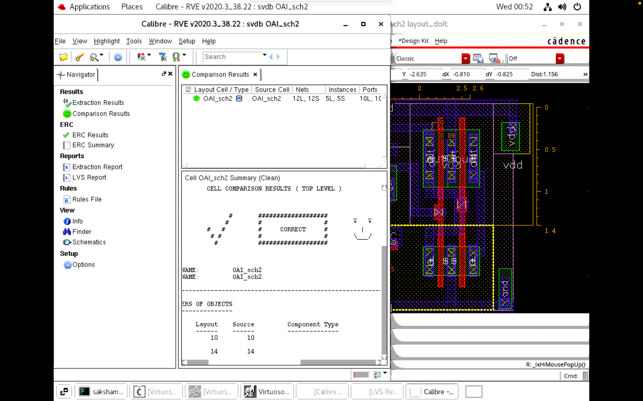
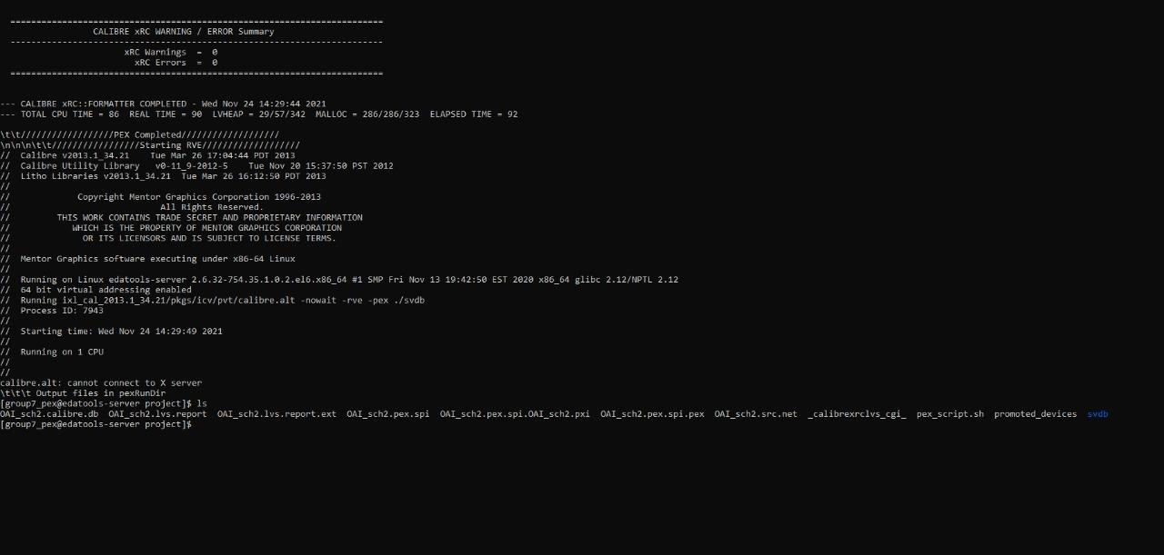
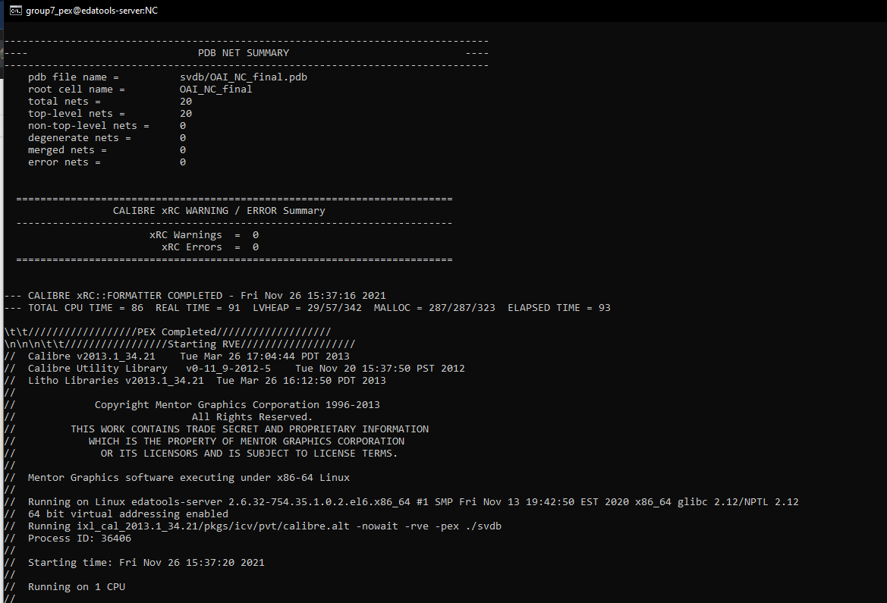
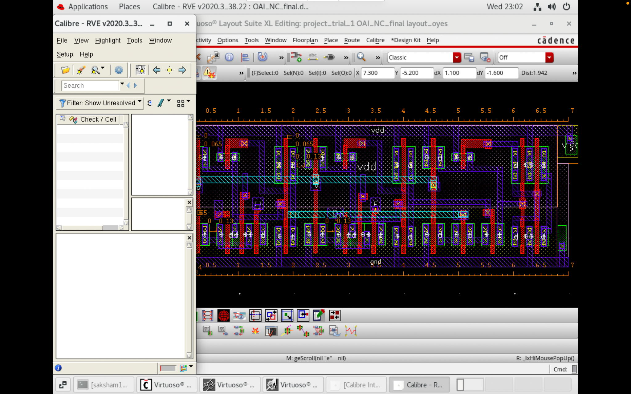
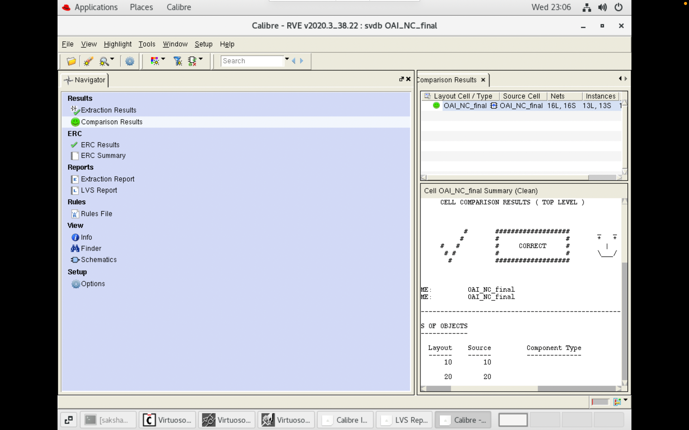
DRC, LVS, PEX Results
Complex
Non Complex

Slide 6
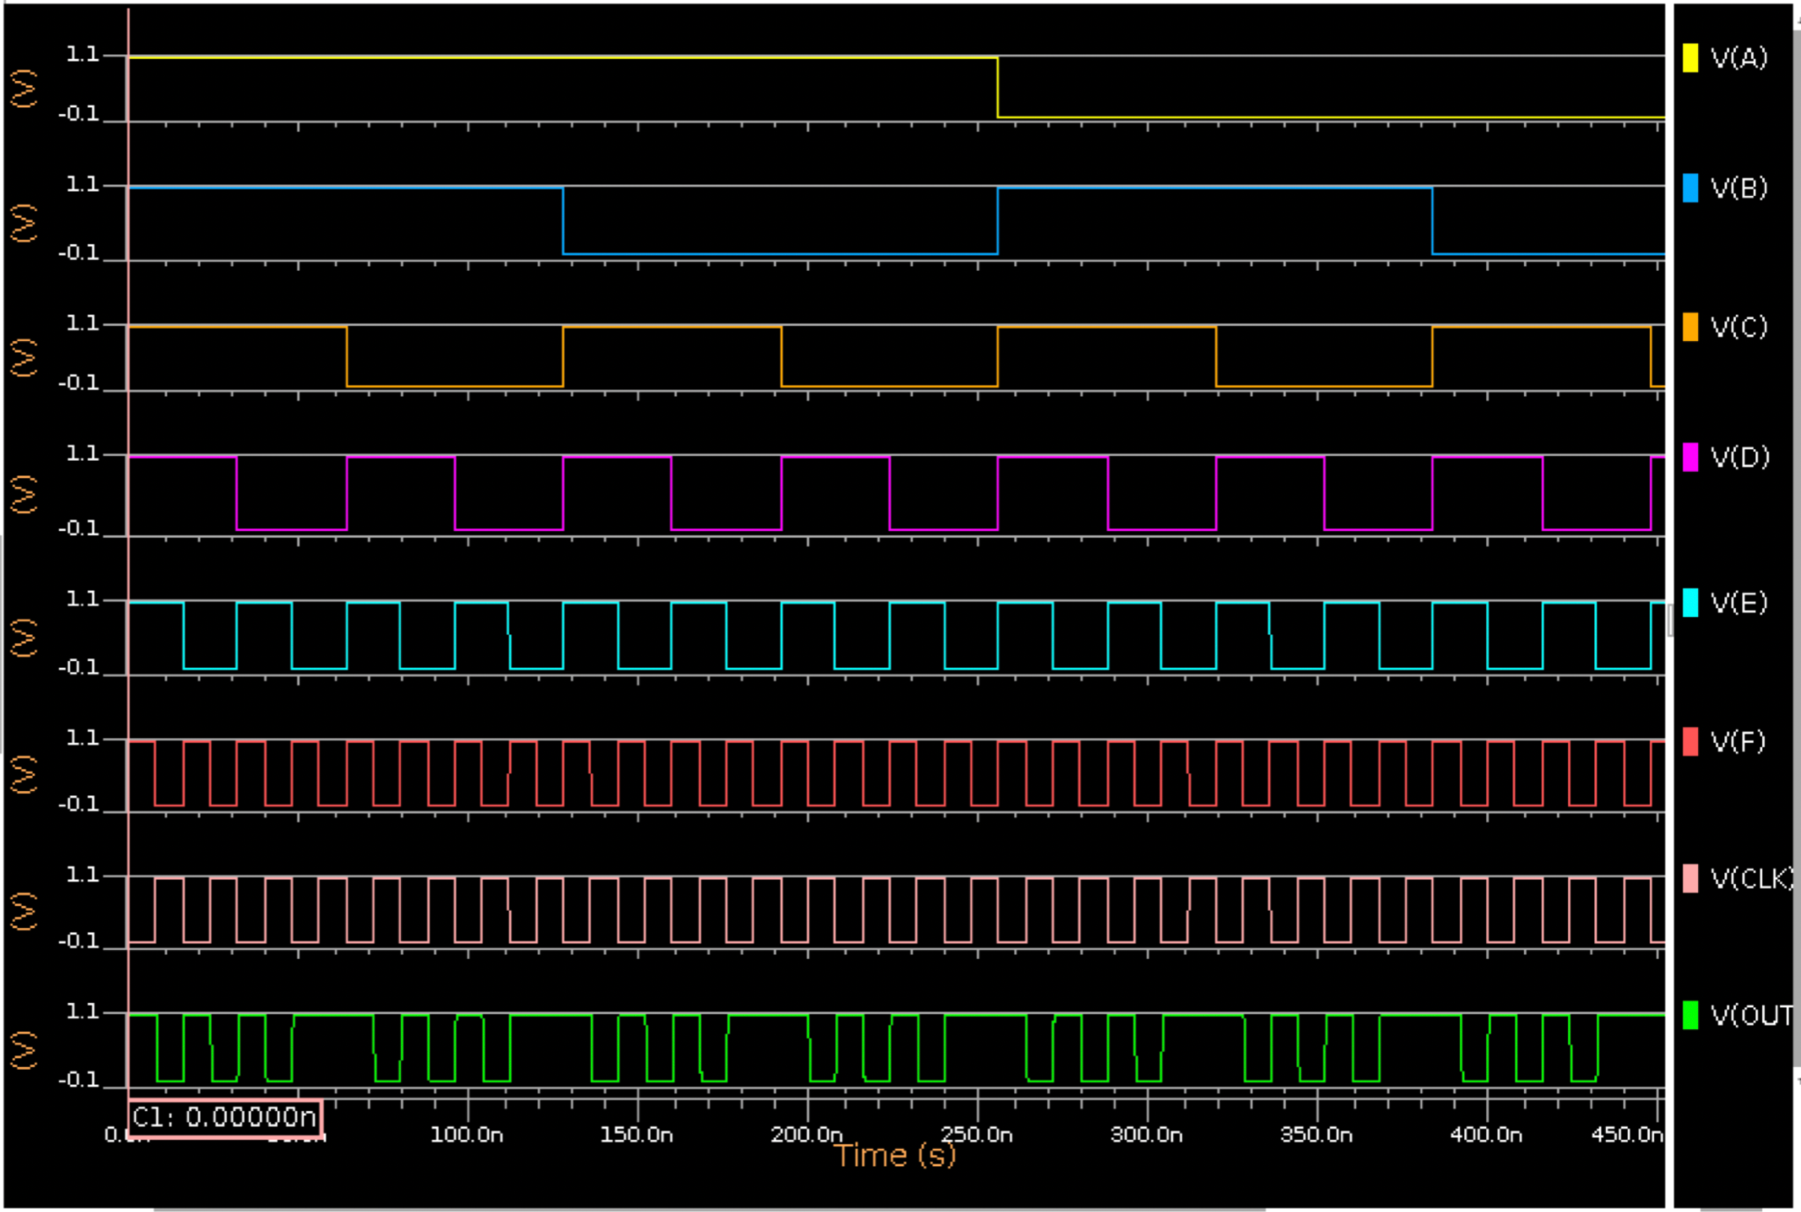
Simulation Waveforms
Complex
Non Complex
Same waveforms for both Complex and Non Complex Design verifies the functionality.

Slide 7
Complex-Pre & Post Layout
RISE AND FALL DELAYS
PVT CORNER | T-fall (Pre-Layout) | T-fall (Post-Layout) | T-rise (Pre-Layout) | T-rise (Post-Layout)
SS, 1.08, 125 | 0.19676 | 0.19104 | 0.18563 | 0.1857
SS, 1.08, 25 | 0.17274 | 0.16806 | 0.1693 | 0.16947
SS, 1.08, -40 | 0.15475 | 0.15081 | 0.15409 | 0.15471
TT, 1.2, 25 | 0.11789 | 0.11541 | 0.12086 | 0.12134
FF, 1.32, 125 | 0.099496 | 0.097815 | 0.10355 | 0.10389
FF, 1.32, -40 | 0.07895 | 0.077754 | 0.083116 | 0.084044
Scale : Nano Seconds

Slide 8
Complex-Pre & Post Layout
CONTAMINATION AND PROPAGATION DELAYS
 | Pre Condition (A,B,C,D,E,F): (1,1,1,0,0,0) Transition (D,E,F): (0->1) |  | Pre Condition (A,B,C,D,E,F): (0,0,0,0,0,1) Transition (C): (0->1)
PVT CORNER | TCD (Pre-Layout) | TCD (Post-Layout) | TPD (Pre-Layout) | TPD (Post-Layout)
SS, 1.08, 125 | 0.23718 | 0.25207 | 0.32044 | 0.33923
SS, 1.08, 25 | 0.21462 | 0.22895 | 0.28825 | 0.30708
SS, 1.08, -40 | 0.19613 | 0.20946 | 0.25866 | 0.27682
TT, 1.2, 25 | 0.13817 | 0.14757 | 0.17409 | 0.18613
FF, 1.32, 125 | 0.10944 | 0.11670 | 0.13406 | 0.14322
FF, 1.32, -40 | 0.091383 | 0.097378 | 0.1067 | 0.11444
Scale : Nano Seconds

Slide 9
Non Complex-Pre & Post Layout
RISE AND FALL DELAYS
PVT CORNER | T-fall (Pre-Layout) | T-fall (Post-Layout) | T-rise (Pre-Layout) | T-rise (Post-Layout)
SS, 1.08, 125 | 0.19673 | 0.19139 | 0.18556 | 0.18528
SS, 1.08, 25 | 0.1727 | 0.16833 | 0.16931 | 0.16939
SS, 1.08, -40 | 0.15467 | 0.15104 | 0.15399 | 0.15479
TT, 1.2, 25 | 0.11788 | 0.11559 | 0.12079 | 0.12135
FF, 1.32, 125 | 0.099485 | 0.09799 | 0.10350 | 0.10389
FF, 1.32, -40 | 0.078937 | 0.07784 | 0.083098 | 0.084075
Scale : Nano Seconds

Slide 10
Non Complex-Pre & Post Layout
CONTAMINATION AND PROPAGATION DELAYS
PVT CORNER | TCD (Pre-Layout) | TCD (Post-Layout) | TPD (Pre-Layout) | TPD (Post-Layout)
SS, 1.08, 125 | 0.3444 | 0.40539 | 0.36448 | 0.42701
SS, 1.08, 25 | 0.31253 | 0.36982 | 0.33064 | 0.38931
SS, 1.08, -40 | 0.283283 | 0.33621 | 0.29953 | 0.35364
TT, 1.2, 25 | 0.19052 | 0.22288 | 0.19890 | 0.23232
FF, 1.32, 125 | 0.14672 | 0.17021 | 0.15198 | 0.17672
FF, 1.32, -40 | 0.11792 | 0.13656 | 0.12147 | 0.14106
Scale : Nano Seconds

Slide 11
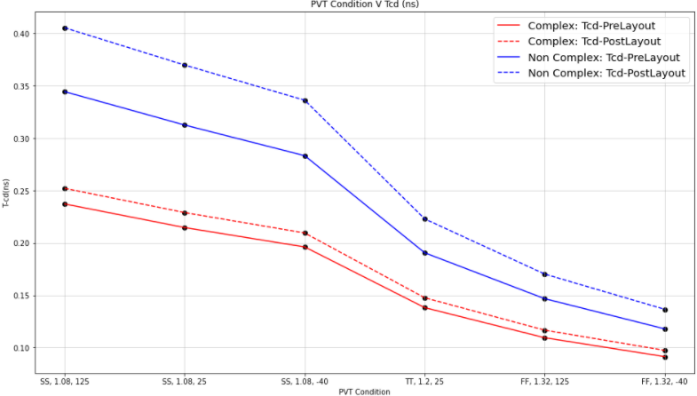
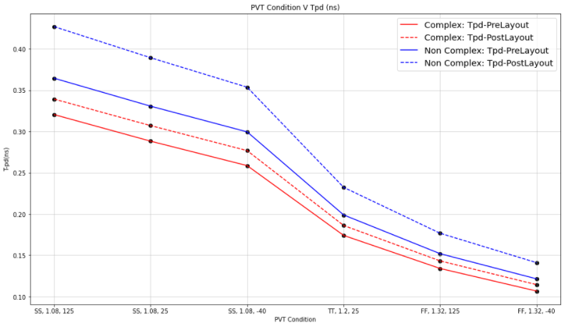
Delay Graphs
Contamination Delay
Propagation Delay

Slide 12
Complex Vs Non-Complex Design
 | COMPLEX | NON COMPLEX | Remark
Number of Transistors | 13 | 25 | Increase in 12 transistors.
Area | 6.72um² | 16.32um² | 2.42 times increase in area for non complex.
T_fall and T_rise | SS, 1.08, 125 | SS, 1.08, 125 | Not much change in T_rise and T_fall from complex to non complex
T_cd | FF, 1.32, -40 | FF, 1.32, -40 | Contamination delay increased in Non Complex by 16%
T_pd | SS, 1.08, 125 | SS, 1.08, 125 | Propagation delay increased in Non Complex by 17%

Slide 13
Leakage and Power Analysis
FF 1.32 125 | COMPLEX |  | NON COMPLEX
 | Pre Layout | Post Layout | Pre Layout | Post Layout
Leakage | 40.267 nA | 46.778nA | 229.36 nA | 245.38 nA
Static Power | 53.153 nW | 61.74nW | 302.76 nW | 323.9016nW
Dynamic Power | 6.1979 uW | 6.557 uW | 8.18 uW | 8.6414 uW
Pre Layout vs Post Layout
Not much change in Leakage and Power between pre and post layout simulations.
Complex vs Non Complex
Leakage Current and Static Power increased 5 times from complex to non complex design.
Dynamic Power increased by 32% from complex to non complex design.
Worst PVT Corner: FF, 1.32, 125

Slide 14
PPA Analysis & Conclusion
We have tried to minimize the area of our design and make a dense layout. Usage of shared diffusion in the nmos for the inputs and bending the nwell from between to accommodate nmos in the p-track region helped us reduce the area.
We have also used shared diffusion regions for inverter in the domino logic to minimize the area.
We have considered minimum DRCs wherever possible to reduce the overall horizontal width of our layout which in turn reduces area.
Non Complex Logic uses more number of transistors and we found the delays increased as moved from complex to non complex designs.
Complex Design is more power efficient than Non Complex Design.

Slide 15

ACKNOWLEDGMENT

Slide 16
Work Distribution
Complex Schematic: Samaksh, Saksham
Complex Layout: Samaksh, Saksham
Non Complex Schematic: Sidharth, Mihir
Non Complex Layout: Saksham, Samaksh, Sidharth
Eldo Scripting: Mihir, Saksham, Samaksh, Sidharth
Simulations: Samaksh, Saksham, Mihir
Graphs and Tables: Sidharth
XCircuit and WaveDrom: Mihir

